Slide 1


GM UNIVERSITY
Davanagere
PBL PRESENTATION ON
“DIGITAL VOTING SIMULATION APP”
Presented by,
IMRAN HASHMI - U25E01AI050
KARTHIK - U25E01AI053
KEERTI S BINJADAGI - U25E01AI056
KEERTHANA R - U25E01AI055
Guide Ms. RAKSHITHA J N | PBL Coordinator Mr. MOHAMMAD ZEESHAN M | HOD Dr. Asha K
B.E, M.Tech
1

Slide 2

CONTENTS
1. Abstracts
2. Introduction
3. Problem statement
4. Objectives
5. Methodology
6. Software and hardware specifications

Slide 3
ABSTRACT
This project presents the frontend development of a Digital Voting Simulation Application, designed to replicate the core experience of electronic voting in a secure, educational, and user-friendly format. Built entirely using HTML, CSS, and JavaScript, and visually enhanced with design assets from Canva, the application simulates key stages of the voting process—voter login, candidate selection, vote casting, and result display—within a clean and responsive interface.
The goal is to promote civic awareness and digital literacy by offering users an interactive platform that mimics real-world voting systems without relying on backend infrastructure. The interface is structured with semantic HTML, styled using responsive CSS, and powered by JavaScript to enable dynamic behaviors such as form validation, vote tracking, and real-time result updates.

Slide 4
INTRODUCTION
Voting is the foundation of democratic participation, yet many individuals—especially students and first-time voters—lack exposure to how digital voting systems function. In an increasingly digital world, understanding the mechanics of electronic voting is essential for civic awareness and technological literacy.
This project introduces a Digital Voting Simulation Application, developed entirely using HTML, CSS, and JavaScript, with visual assets designed in Canva. The goal is to create an interactive, educational platform that simulates the voting process in a secure and user-friendly environment. By mimicking real-world voting stages—such as voter login, candidate selection, vote casting, and result display—the app offers users a hands-on experience without requiring backend infrastructure or sensitive data handling.

Slide 5
PROBLEM STATEMENT
Traditional voting systems are often slow, manual, and prone to human errors. Our challenge: build a Digital Voting Simulation App that transforms abstract civic concepts into an interactive experience—using HTML, CSS, JavaScript, and Canva to create a story-driven, gamified, and visually rich platform. The goal is to make voting feel personal, accessible, and memorable for learners across diverse backgrounds.

Slide 6
OBJECTIVES
Build a structured frontend interface using semantic HTML5 to represent key stages of the voting process: login, candidate selection, vote casting, and result display.
Design civic-themed visual assets using Canva, including banners, icons, and UI mockups that reflect democratic values and enhance user engagement.
Style the application with responsive CSS3, ensuring compatibility across devices and screen sizes while maintaining a clean and professional look.

Slide 7
SOFTWARE REQUIREMENTS
HTML5 – Structure the voting interface
CSS3 – Style the layout with civic-themed visuals
JavaScript – Power vote logic and interactivity
Canva – Design banners, icons, and UI mockups
Visual Studio Code – Code editor for development
Live Server – Real-time preview while coding
Web Browser – Test and demo the simulation
Git & GitHub – Version control and project hosting
DevTools – Inspect, debug, and refine the frontend

Slide 8
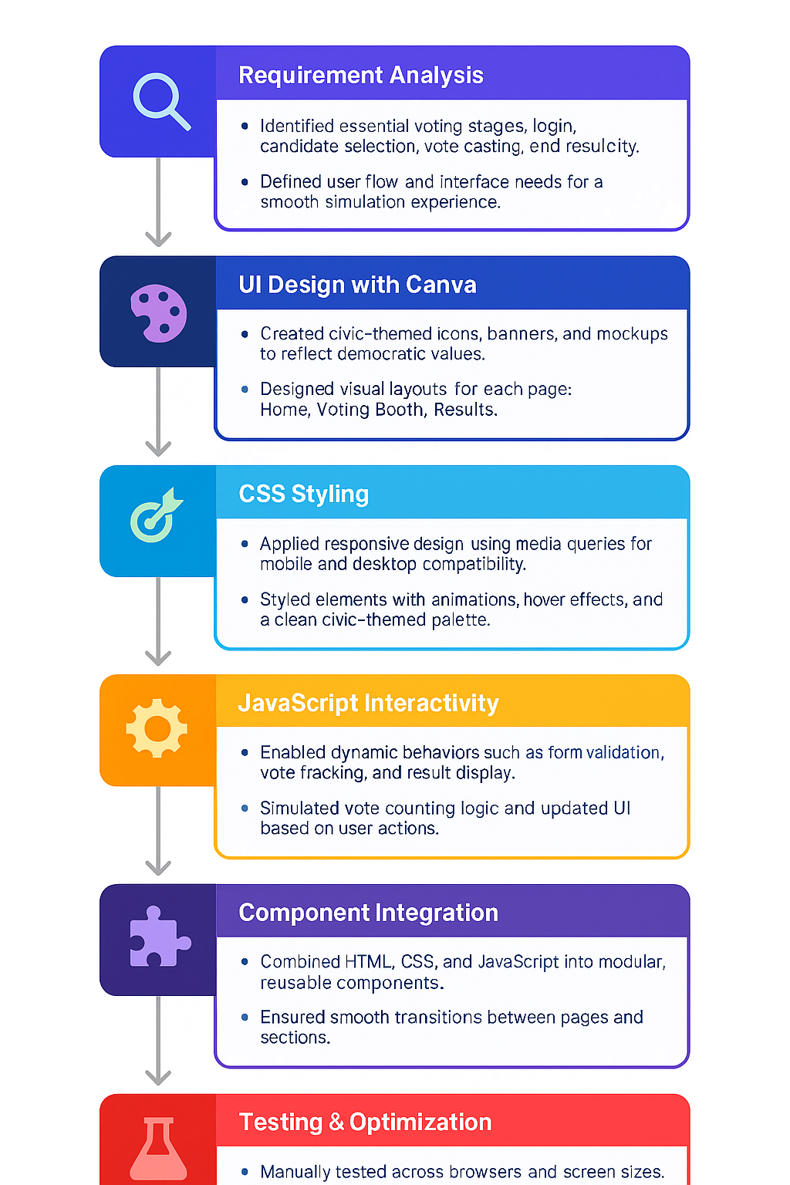
METHODOLOGY
Testing & Optimization
Manually tested across browsers and devices.

Slide 9

Thank you all
12

